Slide 1
Operating system
An Operating System (OS) is a collection of software that manages computer hardware and software.
Without an Operating System, a computer would be useless.
The Operating System acts as interface between the user and the computer.
The OS allows the user to communicate with the computer without having to know the computer's language.

Slide 2
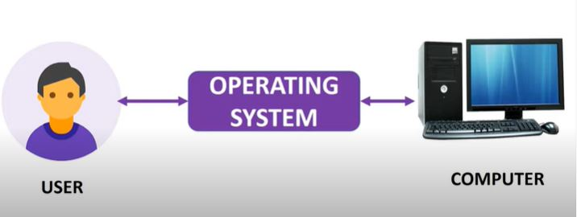

Slide 3
User
Interface
Memory
Management
Security
OS
Multitasking
Peripheral
Management

Slide 4
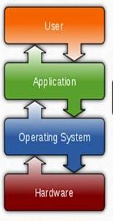
Important functions
Memory management
Processor management
Device management
File management
Security
Control over System performance
Coordination between other softwares and users

Slide 5
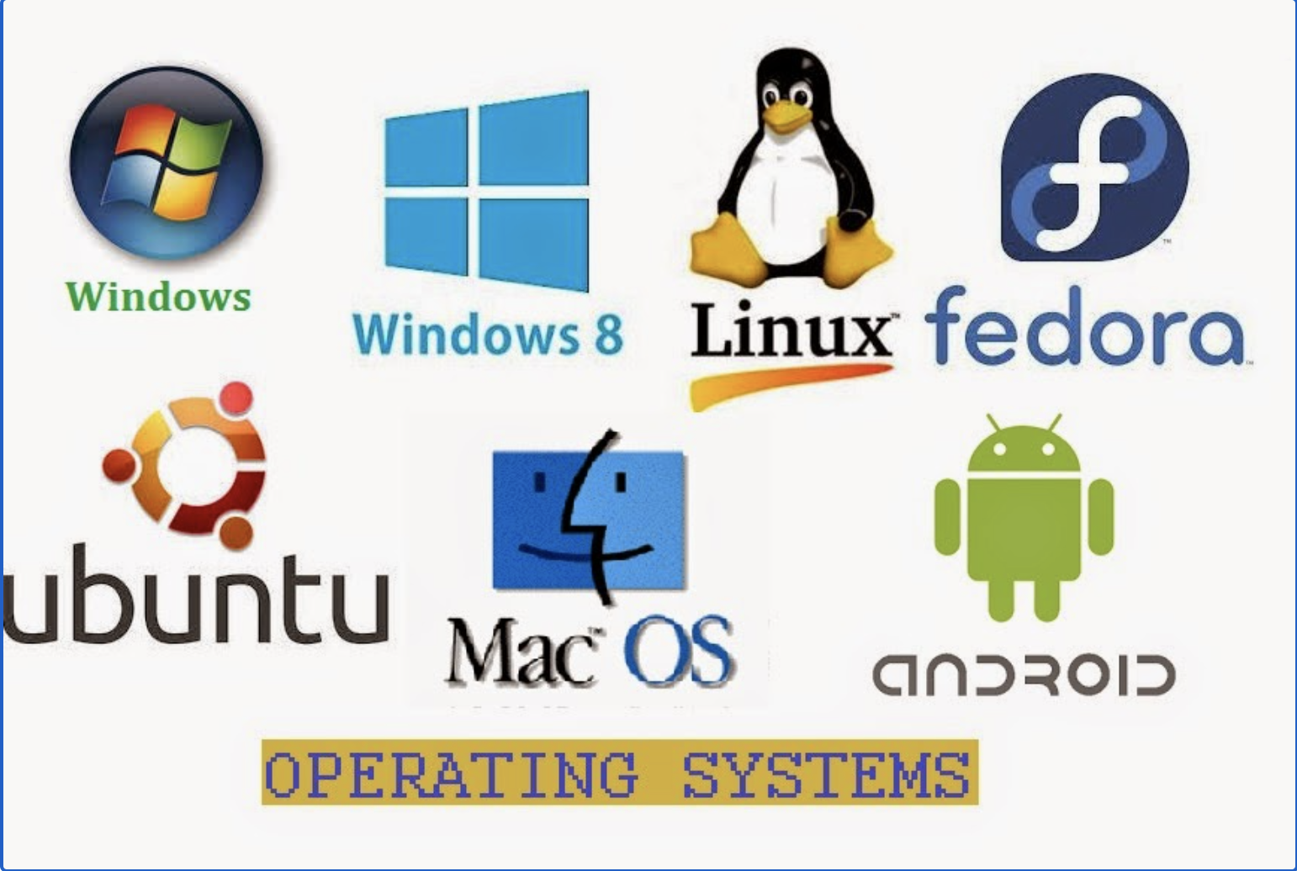
Types of OS

Slide 6
Are cell-phones also computers?
Yes, Cellphones are also computers. Android OS is used in cellphones.
Teachers can show the following things to show how it is similar to Windows.
File manager. Similar to Windows Explorer.
Square button in the bottom which shows all the running apps. Similar to task manager.
Split mode if it is available on your phone. Similar to multiple windows and active window in Windows.
Cut from one app and paste it into another app. i.e. Same clipboard behaviour.
OS version details in the Settings -> System.
RAM and system speed details.

Slide 7
Thank you

